Slide 1
Blind estimation of acoustic transfer functions (ATFs) and dereverberation based on convolutive transfer functions (CTFs) Date：2022. 08. 16
Telecom Electroacoustics Audio(TEA) Lab
Presenter:
Anchi Yuan
Notes:
Hello everyone
I’m today’s presenter siang. I’m going to share some of my present work in source separation problem. My topic is comparative studies of source separation using semi-blind and blind source separation approaches.

Slide 2
Outline
Simulation setting
Simulation result
Future work

Slide 3
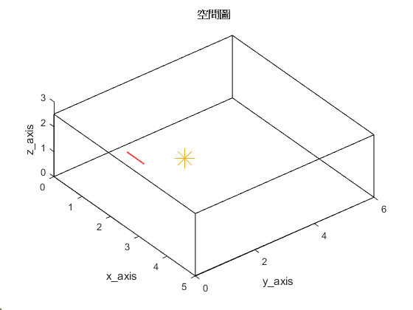
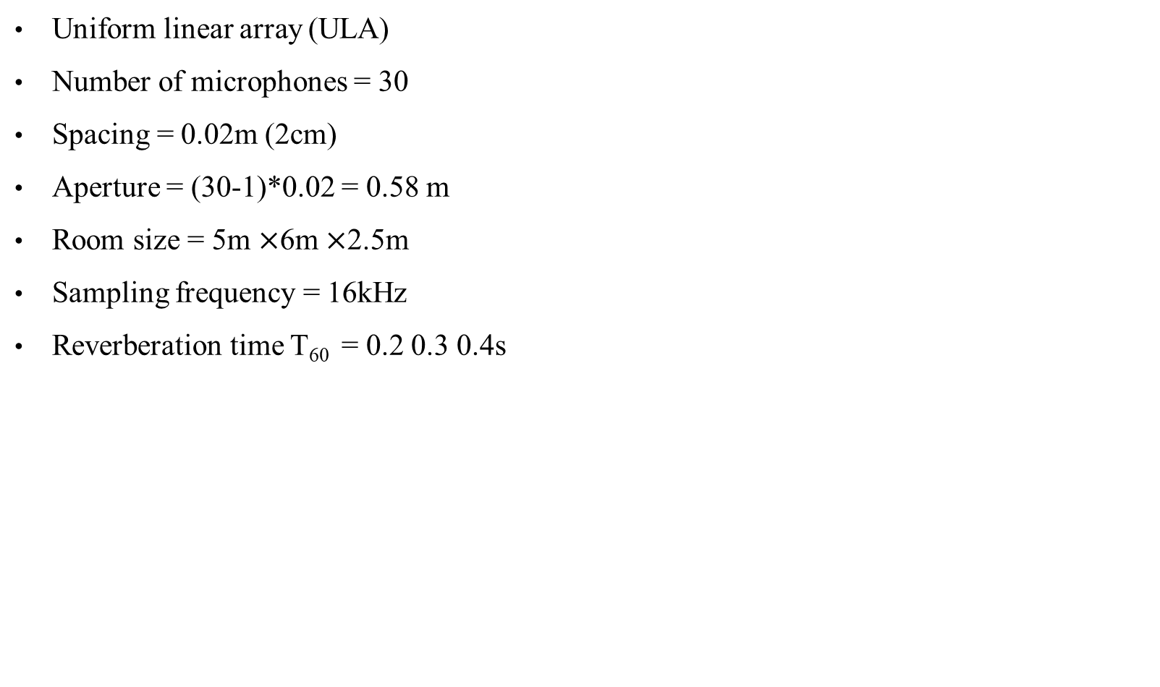
Simulation setting
Uniform linear array (ULA)
Number of microphones = 30
Spacing = 0.02m (2cm)
Aperture = (30-1)*0.02 = 0.58 m
Room size = 5m $×$6m $×$2.5m
Sampling frequency = 16kHz
Reverberation time T₆₀ = 0.2 0.3 0.4s
First microphone location [1, 1.5, 1]
2.5m
Source location [2, 2.6, 1]
origin
5m
6m

Slide 4

Simulation result
 | Ground-truth source | WPE | MINT
T₆₀ = 0.2s
T₆₀ = 0.3s
T₆₀ = 0.4s

Slide 5
Future work
WPD + RLS
Kalman filter

Slide 6


